Slide 1
Randomized Algorithms
Randomized Quick Sort

Slide 2
Given an array A of n distinct integers, in the indices A[1] through A[n], permute the elements of A, so that A[1] < A[2]...A[n].
The assumption of distinctness simplifies the analysis. It has no bearing on the running time.

Slide 3
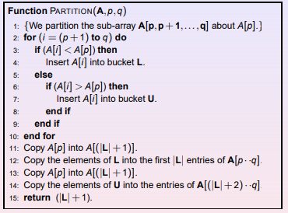
Partitioning an array can be achieved in linear time.

Slide 4
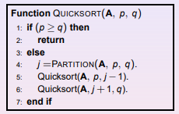

Slide 5
What is the worst-case input for QUICKSORT()?
How many comparisons in the worst case? O(n² )
What sort of assumptions are reasonable in analysis?

Slide 6
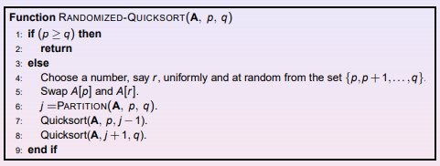
Worst case running time? O(n ² )! ! However, for a randomized algorithm we are not interested in worst-case running time, but in expected running time

Slide 7
we can sometimes add randomization to an algorithm in order to obtain good average-case performance over all inputs.
Many people regard the resulting randomized version of quicksort as the sorting algorithm of choice for large enough inputs
we randomized our algorithm by explicitly permuting the input.
We could do so for quicksort also, but a different randomization technique, called random sampling, yields a simpler analysis.
Instead of always using A[r] as the pivot, we will use a randomly chosen element from the subarray A[p . .r].

Slide 8
We do so by exchanging element A[r] with an element chosen at random from A[p . .r].
This modification, in which we randomly sample the range p,...,r, ensures that the pivot element x = A[r] is equally likely to be any of the r − p + 1 elements in the subarray.
Because the pivot element is randomly chosen, we expect the split of the input array to be reasonably well balanced on average.
The changes to PARTITION and QUICKSORT are small. In the new partition procedure, we simply implement the swap before actually partitioning

Slide 9
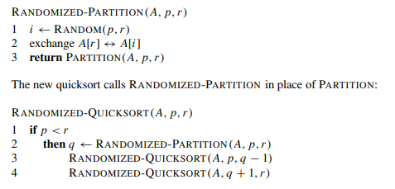

Slide 10
Why do we analyze the average case performance of the randomized algorithms and not the worst case performance?
Since we can seldom guarantee precisely how an algorithm will be exercised, usually we cannot obtain an average-case measurement that is likely to be accurate. The worst case gives us an upper bound on performance. Analyzing an algorithm's worst case guarantees that it will never perform worse than what we determine.
We analyze the expected run time because it represents the more typical time cost. Also, we are doing the expected run time over the possible randomness used during computation because it can't be produced adversarially, unlike when doing expected run time over all possible inputs to the algorithm.
Why do we perform best case worst case and average case analysis for an algorithm?
It involves analyzing the best-case running time, worst-case performance, and average case complexity of an algorithm. The goal of this type of analysis is to determine how well an algorithm performs in different scenarios based on its input size.

Slide 11
